Slide 1
Computer Organization Course Introduction
by Akkradach W.
Dept. of Computer Engineering
KMITL

Slide 2
Goals
Concept and Structure of Computer
Concept and Structure of Microprocessor
Microprocessor Evolution
CISC, RISC, VLIW, x86/64, ARM
Structure of Memory
ROM, RAM, Cache
Information Storage
Internal and External I/O System
Low-Level and Assembly Programming

Slide 3
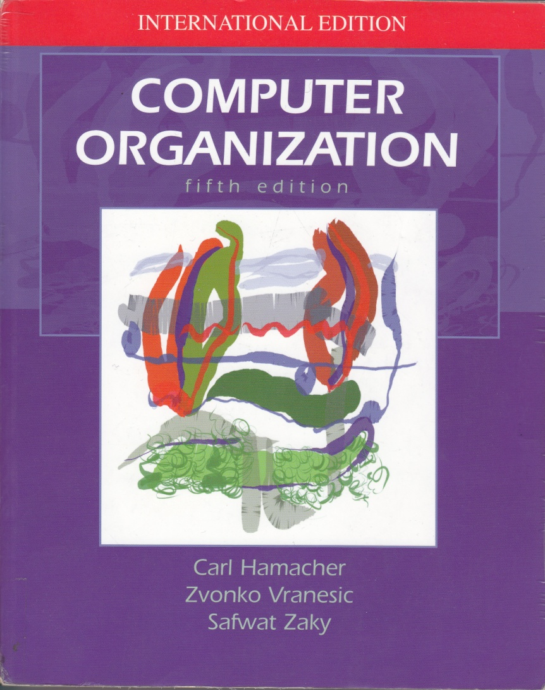
Textbooks (1/3)
Computer Organization 5th Edition
by
Carl Hamacher
Zvonko Vranesic
Safwat Zaky

Slide 4
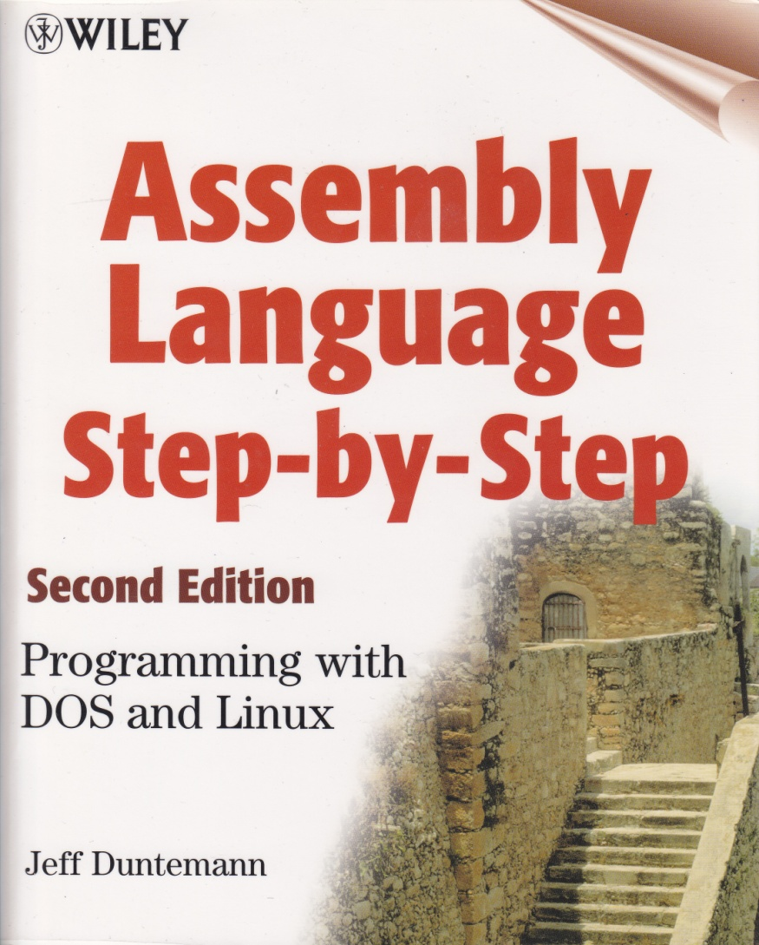
Textbooks (2/3)
Assembly Language Step-by-Step 2nd Edition
by
Jeff Duntemann

Slide 5
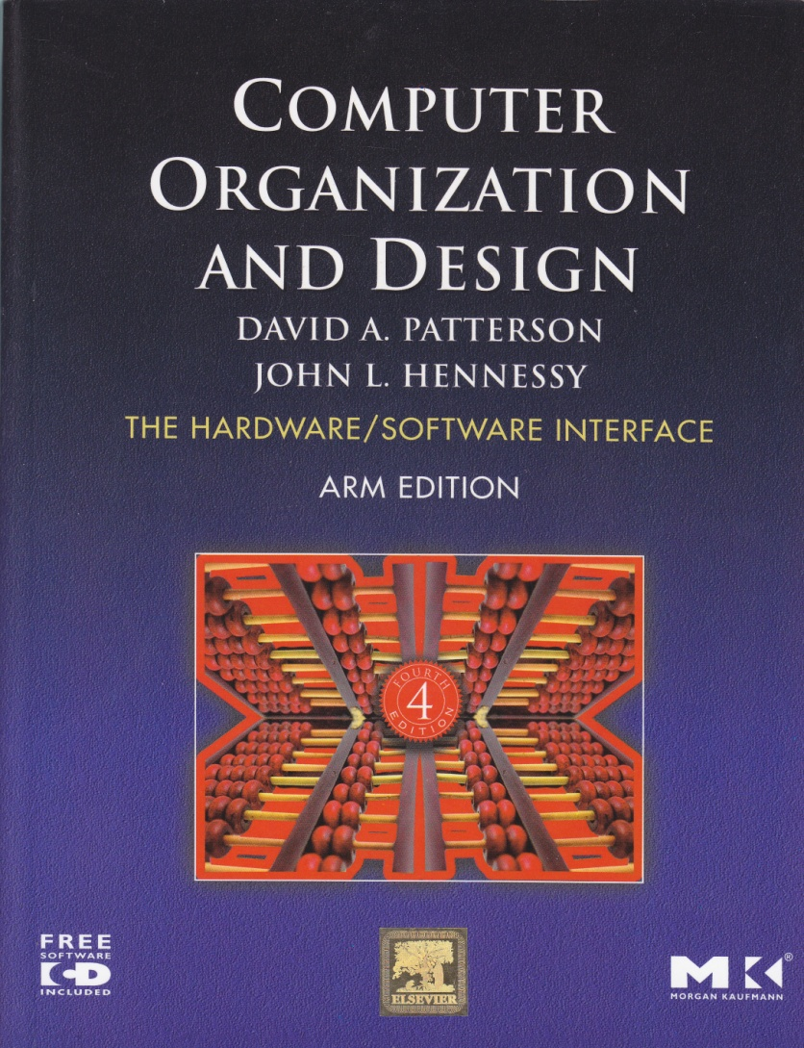
Textbooks (3/3)
Computer Organization and Design ARM Edition
by
David A. Patterson
John L. Hennessy

Slide 6
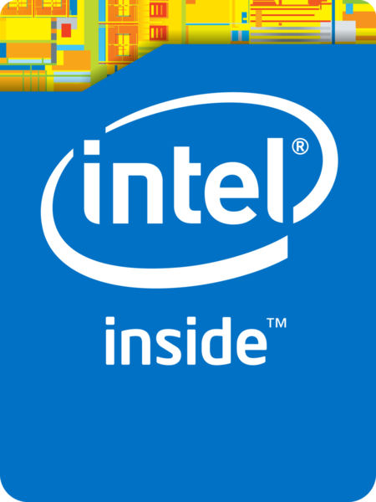

References
Intel® 64 and IA-32 Architectures Software Developer’s Manual (September 2015)
ARM® Cortex®-M3 Processor Technical Reference Manual (Revision: r2p1)

Slide 7
Environment and Tools
OS/VM/Emu
DOSBox*^{preferred}
FreeDOS
MS Windows
Compiler
TASM (DOS)*^{preferred}
NASM (DOS & Others)
Debugger
Turbo Debugger (DOS)*^{preferred}
IDA Pro (Windows)

Slide 8
Schedule (1/2)
#1 Introduction
#2 Basic Concepts (VM, Binary system)
#3 Assembly Language Fundamentals
#4 Concept and Structure of Computer
#5 Assembly Language Programming I
#6 Microprocessor I (x86/64)
#7 Assembly Language Programming II

Slide 9
Schedule (2/2)
#8 Microprocessor II (ARM)
#9 Memory & ASM III
#10 Internal and External I/O & ASM IV
#11 Information Storage & PBL #1
#12 PBL #2
#13 PBL #3
#14 Conclusion & PBL #4

Slide 10
Scoring
Assignment #1 5%
Assignment #2 5%
Assignment #3 5%
Assignment #4 5%
Assignment #5 20%
Midterm Exam (Open) 30%
Final Exam (Open) 30%

Slide 11
Assignments
Instruction Set Summary
Fill ‘O’ Char
The Matrix – Screen
The Matrix – Game
Open Project

Slide 12
Problem-based Learning
Wireless (2 groups)
Ports & Slots (7 groups)
Storage Interfacing & Devices (7 groups)
Firmware & Device Drivers (5 groups)

Slide 13
PBL: Goals
Connectivity Evolution
Wired VS Wireless
Internal VS External
Information Storage
Storage Interfacing
Storage Devices
HW & SW Integration
Firmware
Device Driver

Slide 14
PBL: Problem?
What’s the problem?
Control VS Transfer
A bit VS a BULK
Near VS Far
Single VS Multiple VS Zero Line
Communication VS Capability
How was it born?
How does it work?

Slide 15
PBL: Answer!
History and Timeline
Fundamental, Principle, and Limitation
Photos, Clips, Layouts, and Diagrams
De facto and Standards
Pros and Cons
Examples and Usages
Q&A

Slide 16
PBL: Schedule (1/2)
#1 Wireless (2)
IrDA, Bluetooth
#2 High Latency – Ports (4)
COM, LPT, USB, Firewire
Low Latency – Slots (3)
ISA, PCI, PCI++

Slide 17
PBL: Schedule (2/2)
#3 Storage Interfacing (4)
IDE, SCSI, SATA, SAS
Storage Devices (3)
HDD, SSD, RAID
#4 Firmware (PC, MAC) (5)
Device Drivers
Windows, Linux, BSD

Slide 18
DOSBox Preparation (1/2)
Download from dosbox.com then Install
Copy stuffs to C:\LIMBO (or else)
Turbo Assembler >> C:\LIMBO\TASM
Norton Guide >> C:\LIMBO\NG
Example codes >> C:\LIMBO
Append ‘Options’ (dosbox.conf)
mount X C:\LIMBO
path Z:\;X:\TASM;X:\NG;X:\
X:

Slide 19
DOSBox Preparation (2/2)
Test dev tools
tasm HELLO.ASM
tlink HELLO.OBJ /t
HELLO.COM
Recommended programs
Text editor: ASMIDE
Code Debugger: Turbo Debugger
Game: Prince of Persia (MS-DOS)
** Use exit to terminate DOSBox **
Do Not Forget
/t

Slide 20
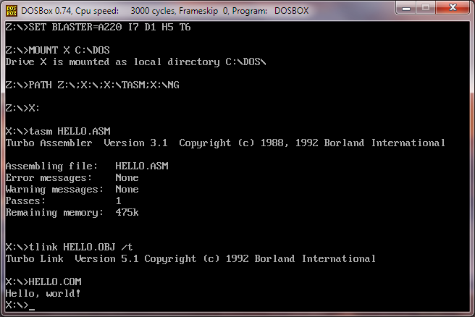
Dev Steps (naïve)

Slide 21
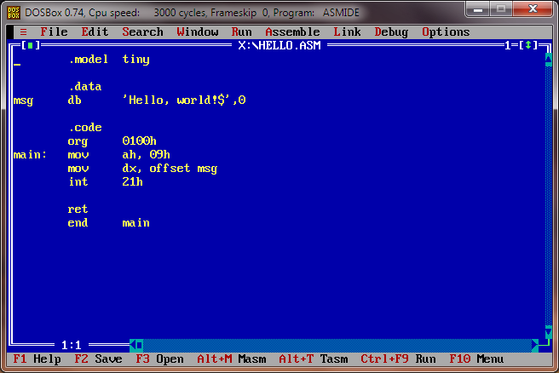
IDE (old school)

Slide 22
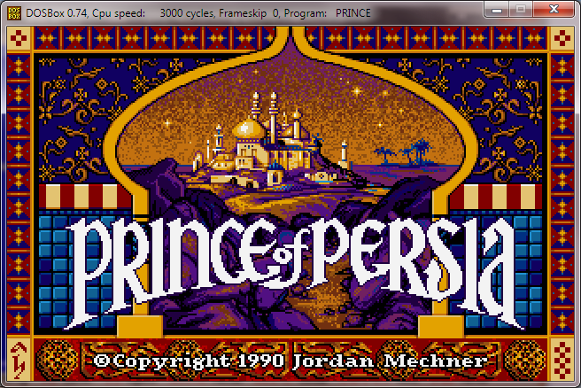
… and the Fabulous Game!

